Slide 1


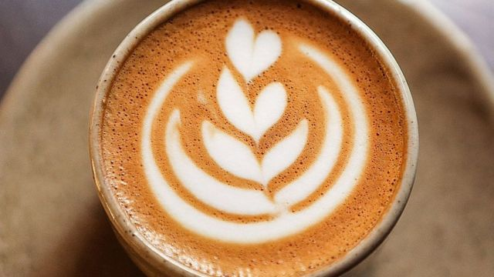
The World’s Favorite Drug?
Speaker:
Alberto cruz Galván (intern 32)

Slide 2
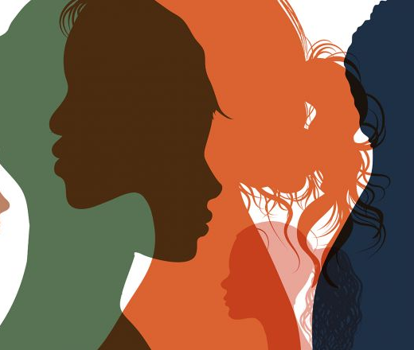
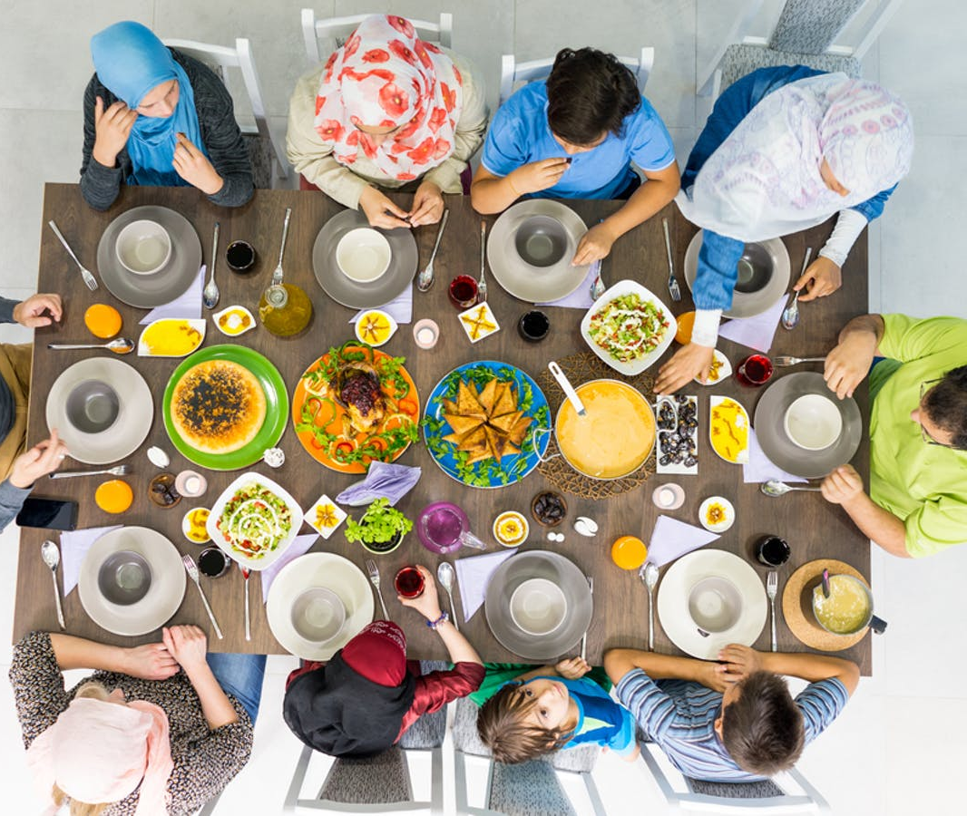
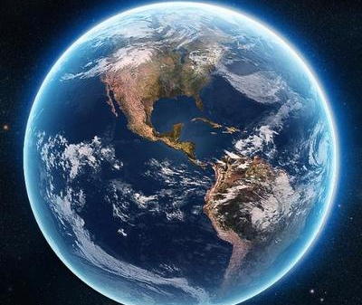
All over the world

Slide 3
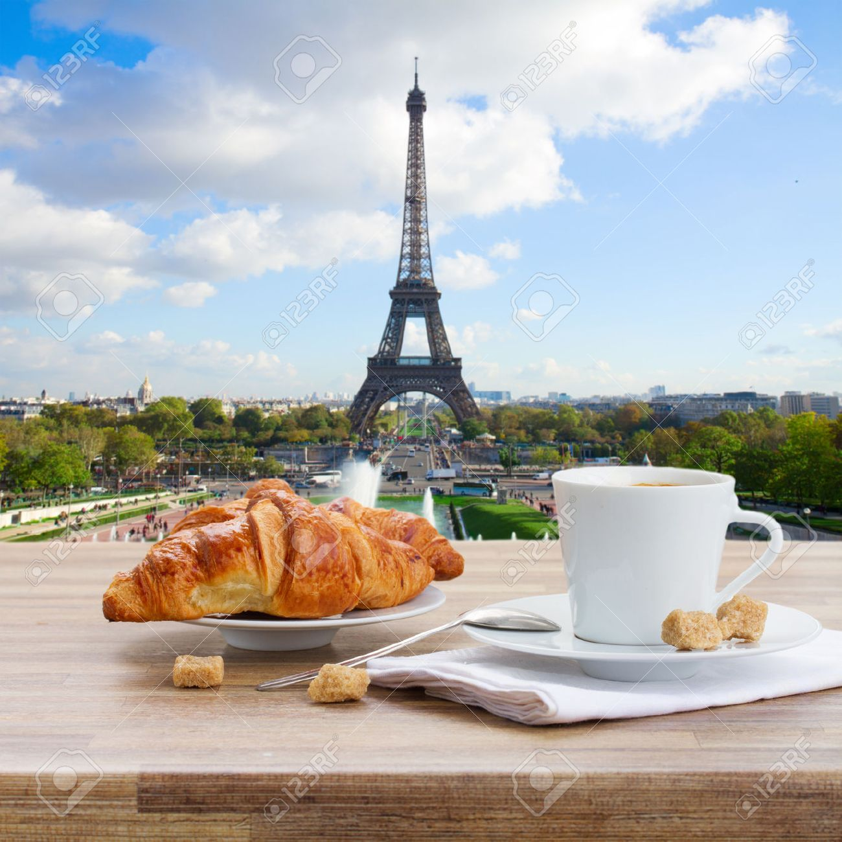

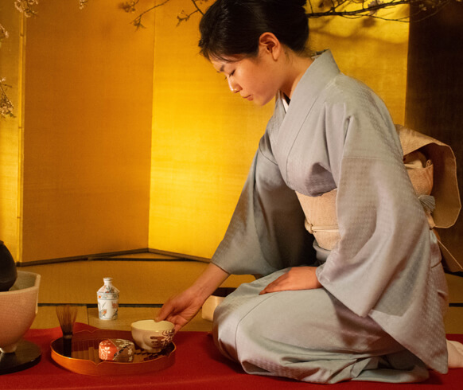
Here we have some examples

Slide 4
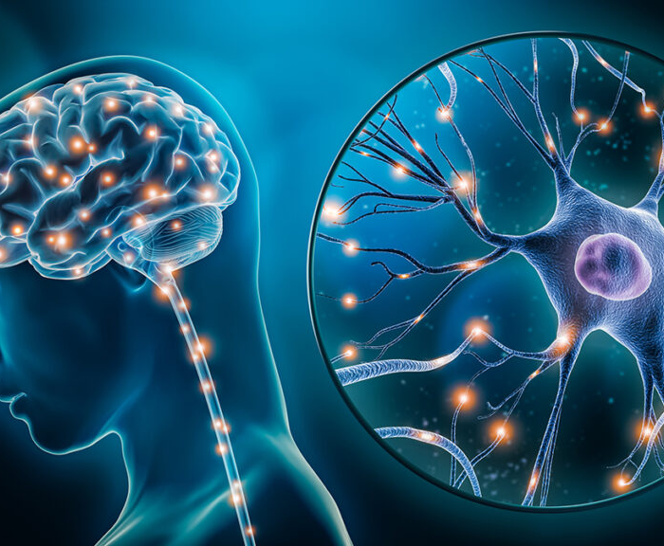
Why do we consume caffeine?

Slide 5

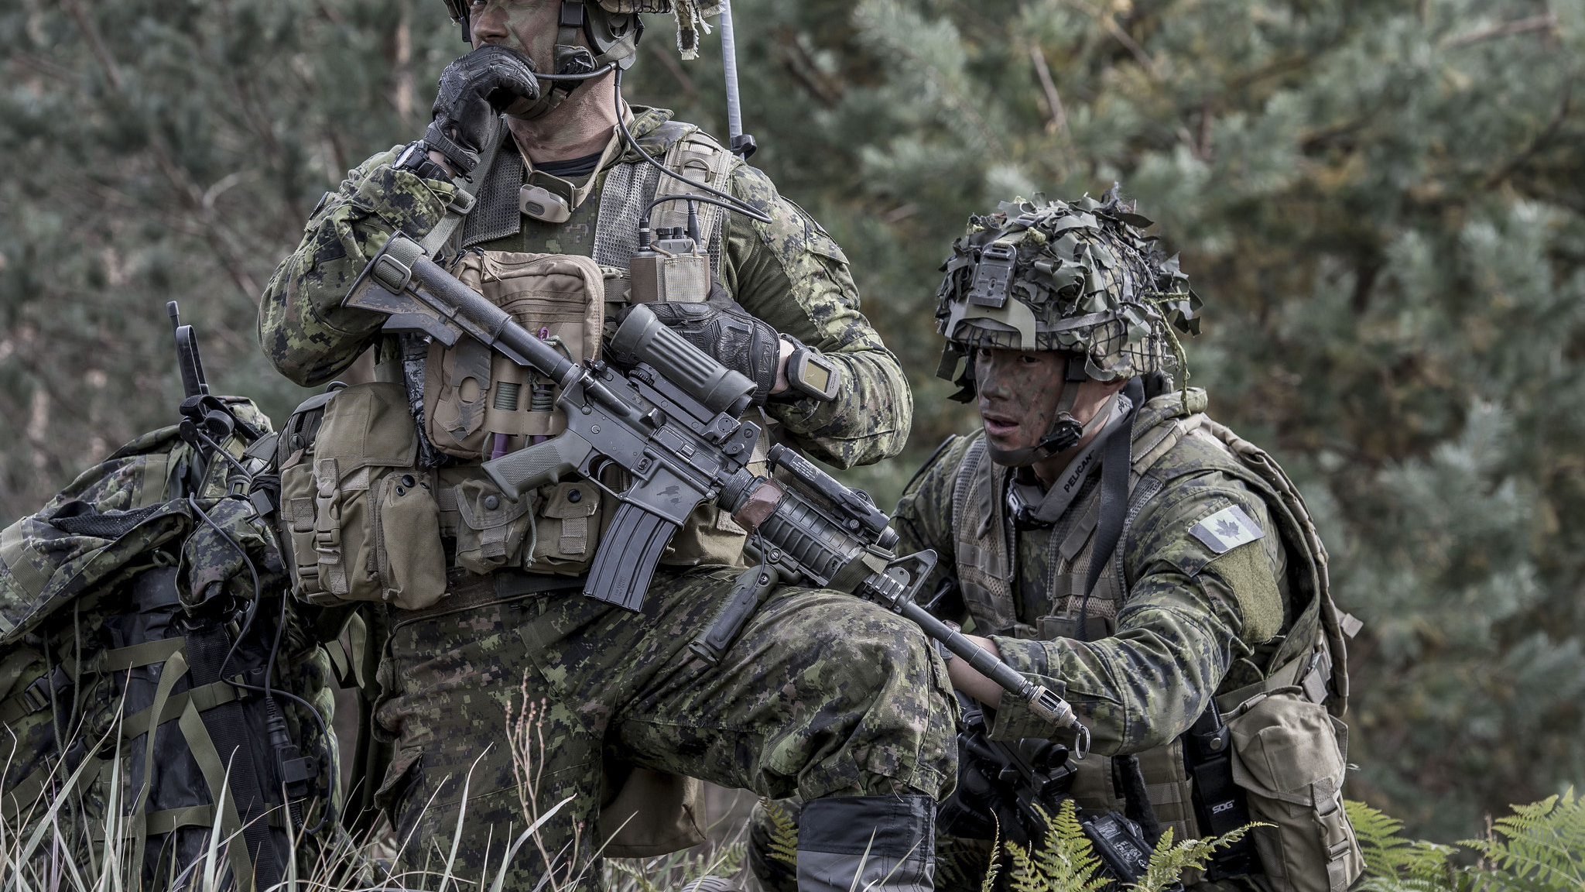
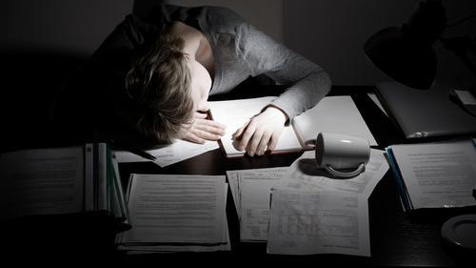
Who do consume caffeine?

Slide 6
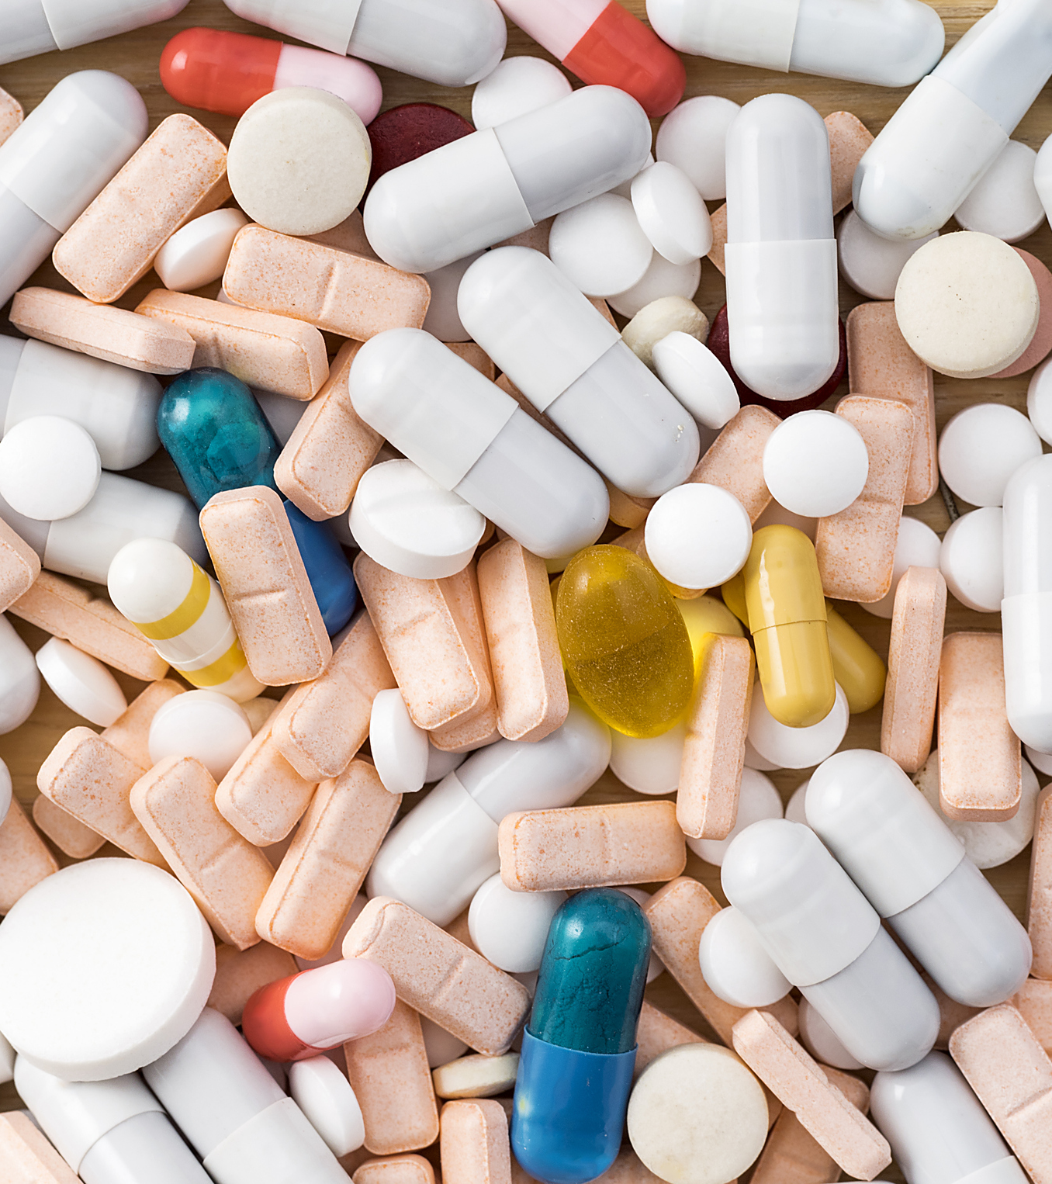
Why may caffeine be considered a drug?

Slide 7
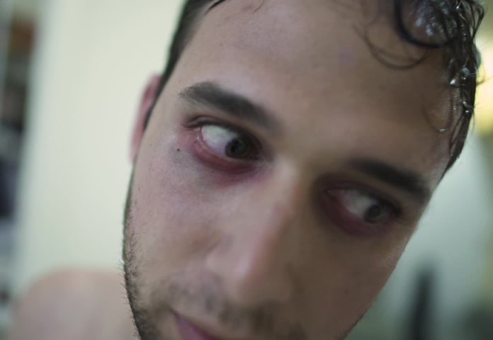




If consumers can’t have a cup of coffee, energy drink or a cup of tea, they may present. (Some scientists opinion).
Physical dependence
headaches
the user’s mood may fluctuate from high to low

Slide 8
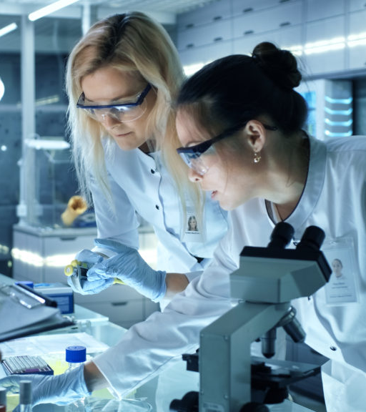
Conclusion

Slide 9
SOURCE
Reading explorer 3. (2010). National Geographic.

